Slide 1
Partner Technical Boot Camp
Infrastructure Track

Slide 2
Agenda
Monday Welcome and Keynote
Tuesday Infrastructure Management
Wednesday Infrastructure as Code
Thursday Containers
Friday Security

Slide 3
Tuesday Infrastructure Management

Slide 4
Tuesday – Infrastructure Management
PST | CET | Session
07:00 – 07:30 | 16:00 – 16:30 | Track Kick-off
07:30 – 08:45 | 16:30 – 17:45 | Lecture Azure Management and Monitoring
08:45 – 09:00 | 17:45 – 18:00 | Break
09:00 – 11:00 | 18:00 – 20:00 | Whiteboard Design Session Managing and Monitoring Azure Workloads
11:00 – 11:15 | 20:00 – 20:15 | Break
11:15 – 12:15 | 20:15 – 21:15 | Lecture Lighthouse Deep Dive
12:15 – 13:15 | 21:15 – 22:15 | Lunch (US only)
13:15 – 16:30 | Tomorrow morning | Hands-On Challenge (Homework Activity) Operationalizing Infrastructure Challenge

Slide 5
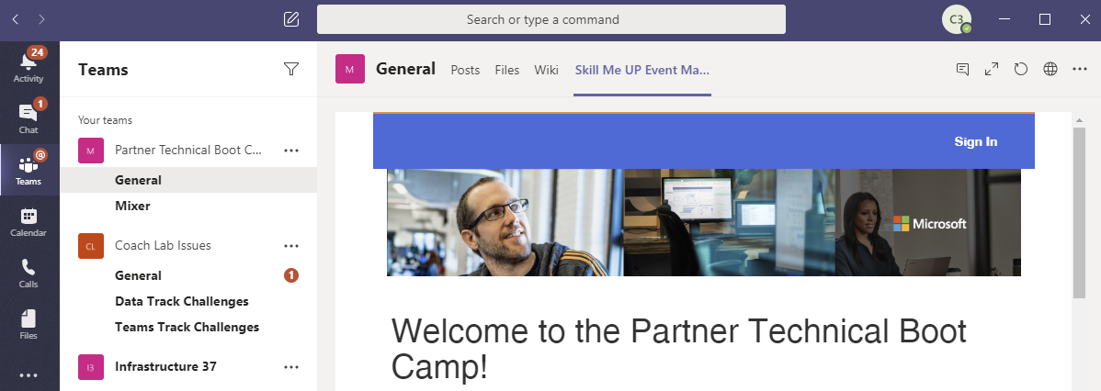
Access the Bootcamp Portal
Log in to Teams using your Bootcamp credentials
attendee-NNN@opspartnerbootcamp.onmicrosoft.com
Use an InPrivate / Incognito browser
Launch the Skill Me Up Event Manager
Partner Technical Boot Camp → General → Skill Me Up Event Manager tag
Click Sign In and re-enter your Bootcamp credentials
Launch in browser if it won't load in Teams ('globe' icon)

Slide 6
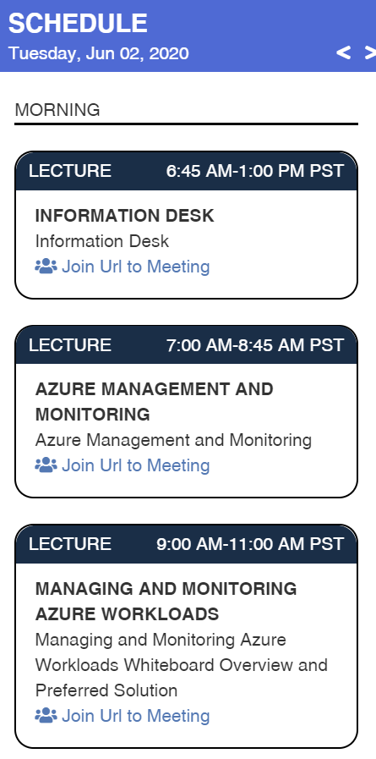
Lectures
Simply click to join the Teams meeting

Slide 7
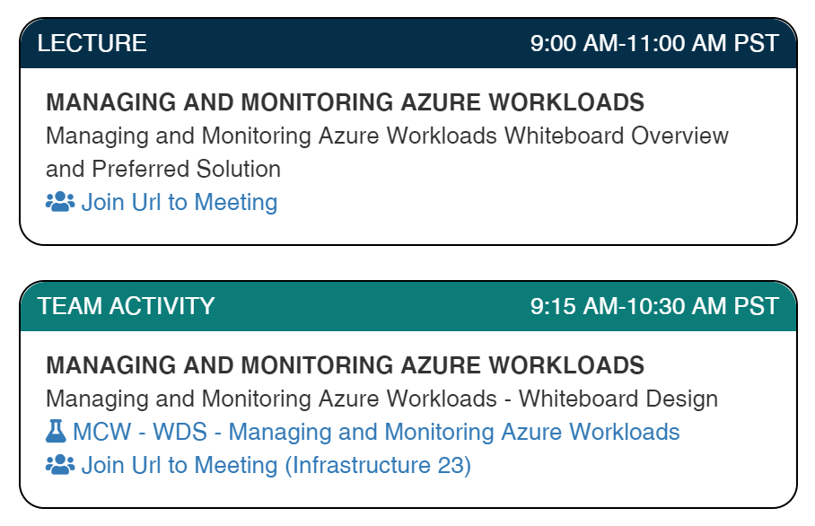
Whiteboard Design Session
Start here for session kick off
Return at 10:45am PST
for example solution
Access the WDS Student Guide
Join you team and coach to design and present your solution

Slide 8
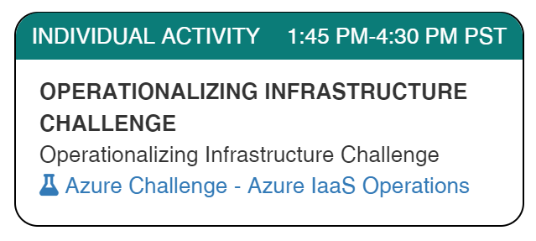
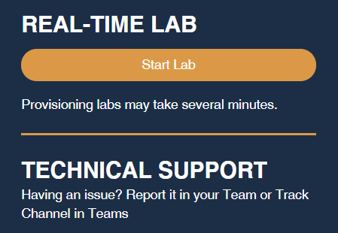
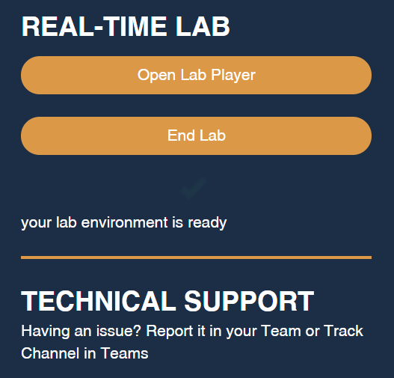
Hands-On Challenge
Important! Allow at least 1 hour for your lab to start

Slide 9
Wednesday Infrastructure as Code

Slide 10
Wednesday – Infrastructure as Code
PST | CET | Session
07:00 – 07:30 | 16:00 – 16:30 | Daily Recap
07:30 – 08:45 | 16:30 – 17:45 | Lecture Advanced Automation with ARM Templates
08:45 – 09:00 | 17:45 – 18:00 | Break
09:00 – 10:00 | 18:00 – 19:00 | Lecture Leveraging Runbooks to Automate Tasks
10:00 – 11:00 | 19:00 – 20:00 | Hands-On Challenge Azure Automation Challenge
11:00 – 11:15 | 20:00 – 20:15 | Break
11:15 – 12:15 | 20:15 – 21:15 | Hands-On Challenge (continued) Azure Automation Challenge

Slide 11
Operationalizing Infrastructure Challenge
Solution Overview

Slide 12
Challenge 1: Automatic On-Boarding to VM Insights
Log Analytics Workspace
Create from portal
Enable VM Insights from Azure Monitor > Virtual Machines > Other onboarding options > Configure a workspace
Assign built-in policy initiatives to enable auto-enrolment
Enable Azure Monitor for VMs
Enable Azure Monitor for Virtual Machine Scale Sets
Run remediation jobs (use 're-evaluate resource compliance' option)
Deploy Log Analytics agent for Windows VMs
Deploy Log Analytics agent for Linux VMs
Notes:
The first step is to create the Log Analytics workspace. You can use any account name but must use the ChallengeRG resource group.
Next, you need to onboard the workspace to VM Insights. This deploys the VM Insights solution. Easiest way is to go to Azure Monitor > Virtual Machines > Other onboarding options > Configure a workspace.
Next, you need to deploy the policies that enable automatic VM enrollment in VM Insights. This basically means deploying the Log Analytics agent (a.k.a. Microsoft Monitoring Agent) and Dependency agent, which for VMs is done via VM extensions. There are built-in policies for this (separate ones for Windows vs Linux, VM vs Arc, VM vs VMSS, each agent). The best is to use the built-in policy initiatives, which bundle these together into two initiatives:
- Enable Azure Monitor for VMs
- Enable Azure Monitor for Virtual Machine Scale Sets
These are easily located from Policy > Definitions > filter for ‘Definition type’ = ‘Initiative’ and ‘Category’ = ‘Monitoring’.
These should both be assigned to the ChallengeRG resource group scope. For security reasons, the lab doesn’t let you assign at subscription scope. This means they must be deployed from Azure Policy, you can’t deploy from Azure Monitor > Virtual Machines > Other onboarding options > Enable using policy. Be sure to specify the workspace in the policy parameters.
The last step is to run remediation jobs to onboard the VMs. You can only run remediation on individual definitions, not initiatives. To save time, the verification engine only tests for the Log Analytics remediation (not Dependency Agent), so the policies to remediate are:
- Deploy Log Analytics agent for Windows VMs
- Deploy Log Analytics agent for Linux VMs
Remediation only runs on resources identified as non-compliant. So you need to wait for the compliance report to generate following policy assignment (about 30 minutes), or use the ‘Re-evaluate resource compliance before remediating’ option when creating the remediation task. Remediation can take a while (mostly the compliance evaluation is slow) so it’s best to run the two remediation tasks in parallel.

Slide 13
Challenge 2: Resource Graph Explorer
resources
| where type =~ 'Microsoft.Compute/virtualMachines'
| mv-expand nics = properties.networkProfile.networkInterfaces
| project
vmId = id,
vmName = name,
OS = strcat(tostring(properties.storageProfile.imageReference.offer), ' ',
tostring(properties.storageProfile.imageReference.sku)),
nicId = tostring(nics.id)
| join kind=leftouter (
resources
| where type =~ 'Microsoft.Network/networkInterfaces'
| mv-expand ipConfig = properties.ipConfigurations
| project
nicId = id,
subnetId = ipConfig.properties.subnet.id,
ipAddress = ipConfig.properties.privateIPAddress
) on nicId
| project
vmName,
OS,
vnetName = split(subnetId, '/')[8],
subnetName = split(subnetId, '/')[10],
ipAddress
Notes:
This challenge is designed to develop a student’s Kusto skills, as well as introducing them to the power of the Azure Resource Graph as a way of exploring resources (tasks that may previously have been implemented using PS or CLI scripts can be better executed in Resource Graph Explorer).
The challenge will require the following Kusto commands (be sure you understand each command and the example solution below):
where
mv-expand
project
join
strcat and split
Note that Resource Graph Explorer only allows 2 uses of mv-expand per query. Some approaches to the challenge could require 3 uses.
The validation runs the student query and the query below, then compares the results. Row order and extra columns are ignored. The number of rows and column names and contents must match exactly.

Slide 14
Challenge 3: Azure Monitor Workbooks
Discover built-in Azure Monitor Workbooks
Explore how to build your own
Visualization types
Data sources
Multiple workspaces (including cross-tenant with Lighthouse)
Many other options
Experiment!

Slide 15
Thursday Containers

Slide 16
Thursday – Containers
PST | CET | Session
07:00 – 07:30 | 16:00 – 16:30 | Daily Recap
07:30 – 08:45 | 16:30 – 17:45 | Lecture Operationalizing Azure Kubernetes Services
08:45 – 09:00 | 17:45 – 18:00 | Break
09:00 – 11:00 | 18:00 – 20:00 | Whiteboard Design Session Designing Operatoins for Azure Kubernetes Services
11:00 – 11:15 | 20:00 – 20:15 | Break
11:15 – 12:15 | 20:15 – 21:15 | Lecture Azure Arc enable Kubernetes
12:15 – 13:15 | 21:15 – 22:15 | Lunch (US only)
13:15 – 16:30 | Tomorrow morning | Hands-On Challenge (Homework Activity) Operationalizing AKS Challenge

Slide 17
Azure Automation Challenge
Solution Overview

Slide 18
Connect to Azure Automation
# Ensures you do not inherit an AzContext in your runbook
Disable-AzContextAutosave –Scope Process
# Log in to Azure
$Conn = Get-AutomationConnection -Name AzureRunAsConnection
Connect-AzAccount -ServicePrincipal `
-Tenant $Conn.TenantID `
-ApplicationId $Conn.ApplicationID `
-CertificateThumbprint $Conn.CertificateThumbprint
# Get subscription and Set-AzContext
# Can also specify a subscription in Connect-AzAccount above
Notes:
This challenge is designed to develop a student’s Kusto skills, as well as introducing them to the power of the Azure Resource Graph as a way of exploring resources (tasks that may previously have been implemented using PS or CLI scripts can be better executed in Resource Graph Explorer).
The challenge will require the following Kusto commands (be sure you understand each command and the example solution below):
where
mv-expand
project
join
strcat and split
Note that Resource Graph Explorer only allows 2 uses of mv-expand per query. Some approaches to the challenge could require 3 uses.
The validation runs the student query and the query below, then compares the results. Row order and extra columns are ignored. The number of rows and column names and contents must match exactly.

Slide 19
Challenge 1: Implement Custom Health Probes
# Get list of Web Server VMs
$webVMs = Get-AzVM -ResourceGroupName $appRGName | where-object { $_.Name -like "$webVMPrefix*" }
# Create script to run on VMs to create healthcheck page
$script = '"Healthcheck page" | Out-File -FilePath "C:\inetpub\wwwroot\healthcheck.html"'
$scriptPath = "$env:TEMP\createhealthcheckpage.ps1"
$script | Out-File $scriptPath -Force -Encoding utf8
# Invoke script on each web VM
foreach ($vm in $webVMs) {
Invoke-AzVMRunCommand -ResourceGroupName $vm.ResourceGroupName -VMName $vm.Name ` -CommandId 'RunPowerShellScript' -ScriptPath $scriptPath -AsJob
}
Get-Job | Wait-Job
# Reconfigure healthcheck path in load balancer probe
$lb = Get-AzLoadBalancer -Name $lbName -ResourceGroupName $appRGName
$probe = Get-AzLoadBalancerProbeConfig -Name $probeName -LoadBalancer $lb
$probe.RequestPath = '/healthcheck.html'
Set-AzLoadBalancer -LoadBalancer $lb$Conn.CertificateThumbprint
Notes:
This challenge is designed to develop a student’s Kusto skills, as well as introducing them to the power of the Azure Resource Graph as a way of exploring resources (tasks that may previously have been implemented using PS or CLI scripts can be better executed in Resource Graph Explorer).
The challenge will require the following Kusto commands (be sure you understand each command and the example solution below):
where
mv-expand
project
join
strcat and split
Note that Resource Graph Explorer only allows 2 uses of mv-expand per query. Some approaches to the challenge could require 3 uses.
The validation runs the student query and the query below, then compares the results. Row order and extra columns are ignored. The number of rows and column names and contents must match exactly.

Slide 20
Challenge 2: Re-Size Load-Balanced VMs
During resize, VMs will reboot, causing 503 Service Unavailable (until the load balancer redirects traffic)
3 approaches
Remove VMs from the LB backend pool
Use NIC-level NSGs to block the health probes, so the VM is taken out of rotation by the load balancer
Remove or rename the /healthcheck.html page, again so the health probes fail and the VM is taken out of rotation
Example solution uses 3rd approach
Again using Invoke-AzVMRunCommand to rename the /healthcheck.html page
No connection draining (available in Application Gateway)
Notes:
At first sight, this looks simple - you just need to resize a couple of VMs.
However, the validation engine is going to probe the website every 1/4 second. As a VM resizes, it must reboot. During the reboot IIS will be shut down, and this will give a short window where a 503 Service Unavailable is returned. The student needs to make sure these are never seen by the end user (or validation probes).
There are several possible approaches to ensuring each VM receives zero traffic during the resize operation:
- Remove VMs from the LB backend pool
- Use NIC-level NSGs to block the health probes, so the VM is taken out of rotation by the load balancer
- Remove or rename the /healthcheck.html page, again so the health probes fail and the VM is taken out of rotation
The solution below uses the last approach. It’s a good opportunity to discuss the pros and cons of each.
The delay in the solution below is hard-coded. A better solution would be to calculate the delay based on the probe interval and retry count.
This solution does not wait for existing connections to drain, it simply stops new connections reaching servers which are being resized. Connection draining is not supported by Azure Load Balancer (it may be coming in future based on this feedback item). It is supported by Application Gateway.
Only the two stated VM sizes are permitted by policy: Standard_DS2_v2 and Standard_B2ms. The validation engine will resize the VMs back to the original size at the start of the validation process if necessary, before running the student runbook.

Slide 21
Challenge 3: Parallel Tasks Using PowerShell Workflow
workflow ParallelDeploy
{
param (
[Parameter(Mandatory)]
[string] $templateUri,
[Parameter(Mandatory)]
[string] $parametersUri
)
# Log in to Azure
Disable-AzContextAutosave –Scope Process
$Conn = Get-AutomationConnection -Name AzureRunAsConnection
Connect-AzAccount -ServicePrincipal `
-Tenant $Conn.TenantID `
-ApplicationId $Conn.ApplicationID `
-CertificateThumbprint $Conn.CertificateThumbprint
# Deploy to each RG in parallel
$RGs = @( "RG1", "RG2", "RG3" )
ForEach -Parallel ($rg in $RGs)
{
New-AzResourceGroupDeployment -Name (New-Guid) `
-ResourceGroupName $rg `
-Mode Incremental `
-TemplateUri $templateUri `
-TemplateParameterUri $parametersUri
}
}
Notes:
The key part of this challenge is that requires students to move from PowerShell to PowerShell Workflow. In particular, they’ll use the Parallel capabilities to speed up the deployment of multiple ARM templates.
(The template deployments could also be parallelized using -AsJob in a normal PowerShell runbook, but the validation engine doesn’t allow that approach, to encourage students to use PowerShell Workflow.)
Overall, this challenge is fairly straightforward.

Slide 22
Friday Security

Slide 23
Friday – Security
PST | CET | Session
07:00 – 07:30 | 16:00 – 16:30 | Daily Recap
07:30 – 08:45 | 16:30 – 17:45 | Lecture Securing Your Infrastructure
08:45 – 09:00 | 17:45 – 18:00 | Break
09:00 – 10:45 | 18:00 – 19:45 | Hands-On Challenge Analyzing Threats using Azure Sentinel
10:45 – 11:00 | 19:45 – 20:00 | Break
11:00 – 11:45 | 20:00 – 20:45 | Lecture Azure VMware Solution
11:45 – 12:15 | 20:45 – 21:15 | Closing

Slide 24
Azure Kubernetes Service Challenge
Solution Overview

Slide 25
Challenge 1
Challenge criteria
Your initial challenge is to configure the existing application in a dedicated namespace
Allow only the Fruit Smashers Smooth Devs security group access to the namespace
Challenge solution
A new cluster will need to be deployed which uses the same VM sizes and number of nodes as the existing cluster
The new cluster needs to be configured for AAD integration
A new namespace has been created that is dedicated to just the ratingsapp
Fruit Smashers Smooth Devs has been granted access to the namespace through a RoleBinding
The existing application has been migrated to the new cluster
This can be done with Velero or through a straight export of the existing deployment
The Kubernetes secret mongosecret needs to be recreated and populated with a value in the new namespace

Slide 26
Create a new cluster using AAD identity
echo "Creating AKS cluster $AKS_CLUSTER_NAME with verion ${VERSION}..."
az aks create \
--resource-group $RESOURCE_GROUP \
--name $AKS_CLUSTER_NAME \
--vm-set-type VirtualMachineScaleSets \
--load-balancer-sku standard \
--location $REGION_NAME \
--kubernetes-version $VERSION \
--network-plugin azure \
--vnet-subnet-id $SUBNET_ID \
--service-cidr 10.2.0.0/24 \
--dns-service-ip 10.2.0.10 \
--docker-bridge-address 172.17.0.1/16 \
--generate-ssh-keys \
--aad-server-app-id 82ee3040-5763-4e07-adfc-144730ebb858 \
--aad-server-app-secret "0~C7B7f~xf8_Vra3.w2RYa409nlEXl54Ao" \
--aad-client-app-id 2e7b3211-5d3a-49f2-8539-c6c3668d2bdb \
--aad-tenant-id 02bdb9a6-0e48-41cb-bbab-542c49c4592e

Slide 27
Grant cluster access to ACR
echo "Update AKS and grant access to ACR..."
az aks update \
--name $AKS_CLUSTER_NAME \
--resource-group $RESOURCE_GROUP \
--attach-acr $ACR_NAME

Slide 28
Recreate mongosecret with namespace
echo "Creating namespace"
kubectl create namespace ratingsapp
COSMOS_KEY=$(az cosmosdb list-connection-strings \
--name $COSMOS_NAME \
--resource-group $RESOURCE_GROUP \
--query "connectionStrings[0].connectionString" | sed -r "s/\\\"//g" | sed -r "s/\?/ratingsdb\?/g")
echo "COSMOS_KEY: ${COSMOS_KEY}"
echo "Creating mongosecret..."
kubectl create secret generic mongosecret \
--namespace ratingsapp \
--from-literal=MONGOCONNECTION="${COSMOS_KEY}"

Slide 29
Deploy app to new namespace
wget https://raw.githubusercontent.com/opsgility/lab-support-public/master/akschallenge/ratingsapp/ratings-api-deployment.yaml
wget https://raw.githubusercontent.com/opsgility/lab-support-public/master/akschallenge/ratingsapp/ratings-api-service.yaml
wget https://raw.githubusercontent.com/opsgility/lab-support-public/master/akschallenge/ratingsapp/ratings-web-deployment.yaml
wget https://raw.githubusercontent.com/opsgility/lab-support-public/master/akschallenge/ratingsapp/ratings-web-service.yaml
echo "Update ACR_NAME in ratings-api-deployment.yaml..."
sed -i "s/ACR_NAME/${ACR_NAME}/g" ratings-api-deployment.yaml
echo "Deploying ratings-api..."
kubectl apply \
--namespace ratingsapp \
-f ratings-api-deployment.yaml
echo "Sleeping for 1 minute..."
sleep 60
kubectl get deployment ratings-api
echo "Deploying ratings-api service..."
kubectl apply \
--namespace ratingsapp \
-f ratings-api-service.yaml
kubectl get endpoints ratings-api
echo "Update ACR_NAME in ratings-web-deployment.yaml..."
sed -i "s/ACR_NAME/${ACR_NAME}/g" ratings-web-deployment.yaml
echo "Deploying ratings-web..."
kubectl apply \
--namespace ratingsapp \
-f ratings-web-deployment.yaml
echo "Sleeping for 1 minute..."
sleep 60
kubectl get deployment ratings-web
echo "Update RATINGS_WEB_DNS_NAME in ratings-web-service.yaml..."
sed -i "s/RATINGS_WEB_DNS_NAME/${RATINGS_WEB_DNS_NAME}/g" ratings-web-service.yaml
echo "Deploying ratings-web service..."
kubectl apply \
--namespace ratingsapp \
-f ratings-web-service.yaml

Slide 30
Add group RBAC
GROUP_ID=$(az ad group show -g "Fruit Smashers Smooth Devs" --query objectId -o tsv)
# Create a new role
apiVersion: rbac.authorization.k8s.io/v1
kind: Role
metadata:
namespace: ratingsapp
name: ratingsappdeveloper
rules:
- apiGroups: [""] # "" indicates the core API group
resources: ["deployments", "replicasets", "services", "endpoints", "pods"]
verbs: ["*"]
# YAML
apiVersion: rbac.authorization.k8s.io/v1
kind: RoleBinding
metadata:
namespace: ratingsapp
name: ratingsappdeveloper-binding
roleRef:
apiGroup: rbac.authorization.k8s.io
kind: Role
name: ratingsappdeveloper
subjects:
- apiGroup: rbac.authorization.k8s.io
kind: Group
name: "<GROUP_ID>"

Slide 31
Challenge 2
Challenge criteria
Configure a new node pool with two nodes and deploy the Guestbook application into a dedicated namespace
Ensure that the Guestbook application can be deployed to only its dedicated pool members
Keep in mind the existing Fruit Smoothies application is currently in production and should not be impacted by the deployment of this new application and its associated services
Only members of the Fruit Smashers Better Devs security group have access to the namespace
Challenge solution
Add a new node pool to the existing cluster and put a taint on the node pool at the time it is created
Apply the provided manifests after adding a toleration to the manifest(s) and creating a new namespace
Create a new RoleBinding and grant Fruit Smashers Better Devs access to the namespace

Slide 32
Challenge 3
Challenge criteria
A dedicated dashboard for each application team which shows them common AKS performance metrics such as:
Overall cluster health
CPU consumption per node
Pod health
A dedicated workbook for their own Ops team which allows for filtering by:
Node pool in the AKS cluster
For each node pool, the pods that are running on the node should be displayed
Challenge solution
Create a new Azure Monitor workbook or dashboard for each application
A new workbook will need to be created for the Ops team to meet the filtering criteria

Slide 33
Thank you.

Slide 34
Agenda

Slide 35
Text layout
Main topic: Segoe UI, size 28pt
Segoe UI, size 20pt for second level
Segoe UI, size 16pt for third level

Slide 36
2 column Text layout
Main topic: Segoe UI, size 28pt
Segoe UI, size 20pt for second level
Segoe UI, size 16pt for third level
Main topic: Segoe UI, size 28pt
Segoe UI, size 20pt for second level
Segoe UI, size 16pt for third level

Slide 37
Title only

Slide 38
Easy to modify 4 column table
Table header | Table header | Table header | Table header
To modify table, first click anywhere in table, so the Table Tools menu is highlighted at top | Layout > To add rows, click into cell and choose, Insert Above or Insert Below | Layout > Shrink or expand column widths by adjusting the Cell Size, or set them to same size with Distribute
To modify the table layout, click Table Tools > Layout To modify the table layout, click Table Tools > Design | Layout > To add rows, click into cell and choose, Insert Left or Insert Right | Layout > Use Alignment settings to adjust text alignment and cell margins | Tip: To quickly add a row, place cursor in this last cell and hit the Tab key

Slide 39
Additional table
 | Header 1 | Header 2 | Header 3 | Header 4 | Header 5 | Header 6
Row 1 | – | – | – | – | – | –
Row 2 | – | – | – | – | – | –
Row 3 | – | – | – | – | – | –
Row 4 | – | – | – | – | – | –

